Slide 1
软件体系结构
3 过程调用体系结构风格
刘旭东
cameran@hit.edu.cn
Sunday, November 8, 2026

Slide 2
主要内容
3.1 软件体系结构风格
  什么是“软件体系结构风格”？
  为什么要提出“SA风格”？
  典型的SA风格都有哪些？
3.2主程序-子过程风格(Main program and subroutine )
3.3面向对象风格(Object oriented System)

Slide 3
3.1 软件体系结构风格

Slide 4
从“建筑风格”开始
Architectural style constitutes a mode of classifying architecture largely by morphological characteristics in terms of form, techniques, materials, etc. (建筑风格等同于建筑体系结构的一种可分类的模式，通过诸如外形、技术和材料等形态上的特征加以区分)。
之所以称为“风格”，是因为经过长时间的实践，它们已经被证明具有良好的工艺可行性、性能与实用性，并可直接用来遵循与模仿 (复用)。

Slide 5
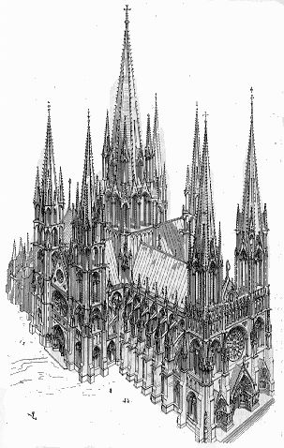

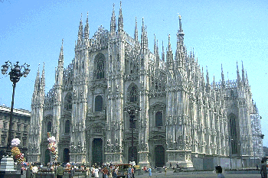



Gothic (哥特式风格)

Slide 6
Gothic architecture (哥特式风格)
Originating in 12th century France and lasting into the 16th century(源于12世纪的法国，并持续到16世纪).
The style emphasizes verticality(强调垂直高度) and features almost skeletal stone structures(石骨架结构) with
  great expanses of glass(优美的彩色玻璃窗画),
  sharply pointed spires(直刺苍穹的尖顶),
  cluster columns(丛生的圆柱),
  flying buttresses(飞扶壁),
  ribbed vaults(有龙骨的拱顶),
  pointed arches using the ogive shape (尖顶形状的圆弧拱门),
  and inventive sculptural detail(强调雕塑的细节).

Slide 7


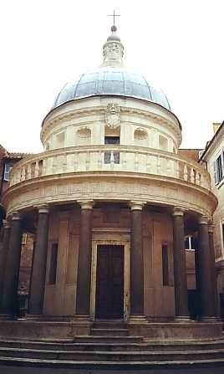
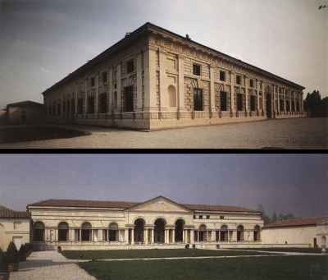
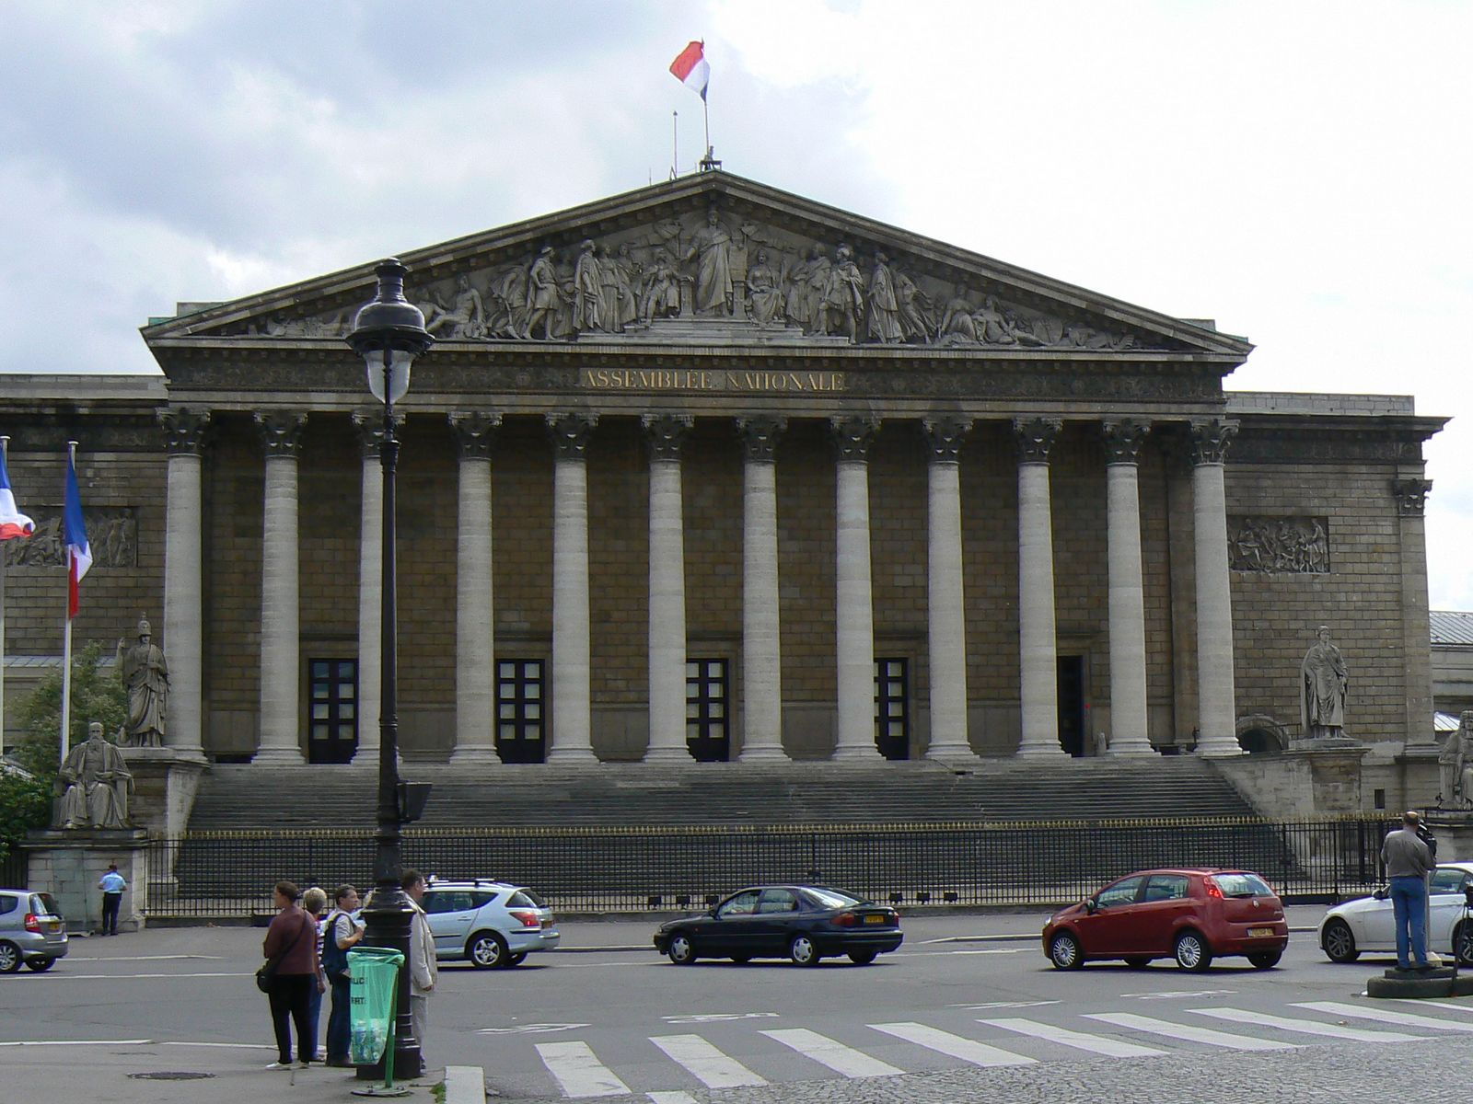
Renaissance architecture (文艺复兴建筑风格)

Slide 8
Renaissance architecture (文艺复兴建筑风格)
Developed first in Florence(发源于意大利弗洛伦萨), demonstrating a conscious revival and development of certain elements of ancient Greek and Roman thought and material culture(借鉴和发扬了古希腊和古罗马建筑思想).
It was expressed in a new emphasis on rational clarity and regularity of parts, arranged in simple mathematical proportions (结构清晰、规则，遵循简单的形状和数学比例).
The style was simply columns and symmetry as opposed to the stone work and irregular gabled facades which preceded the new style (简单的圆柱、对称，区别于日后不规则的、复杂的多面建筑).
Classically-styled columns, geometrically-perfect designs, and hemispherical domes (古典风格的圆柱、完美的几何设计和半球形的屋顶).

Slide 9




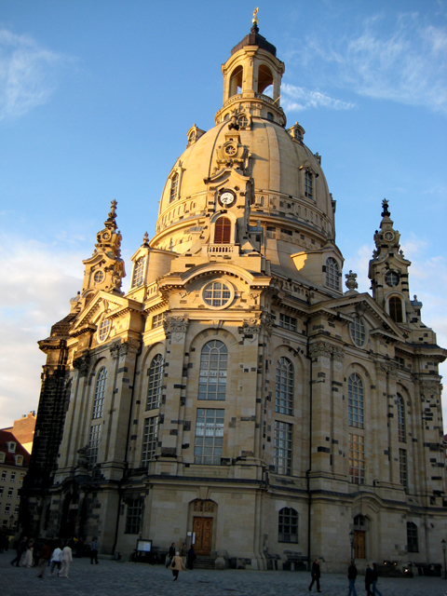

Baroque architecture (巴洛克建筑风格)

Slide 10
Baroque architecture (巴洛克建筑风格)
Starting in late 16th century in Italy (起源于16世纪晚期的意大利)；
long, narrow naves are replaced by broader, occasionally circular forms (狭窄的长条形主殿被替换为宽阔的圆形) ；
dramatic use of light, either strong light-and-shade contrasts, chiaroscuro effects, or uniform lighting by means of several windows (较多的使用光影效果，具有强烈的明暗对比效果，或者使用均衡的光线)；
opulent use of ornaments (较多的使用装饰品)；
large-scale ceiling frescoes (大范围的天花板壁画)；
the external facade is often characterized by a dramatic central projection (从外部看，中央剧烈的突出)；
the interior is often no more than a shell for painting and sculpture (内部则经常只是用来绘画和雕塑)。

Slide 11
回到“软件体系结构风格”
软件系统同建筑一样，也具有若干特定的“风格” (software architectural style)；
  describes a class of architectures(描述一类体系结构)
  is found repeatedly in practice(在实践中被多次应用)
  is a package of design decisions(是若干设计思想的综合)
  has known properties that permit reuse(具有已经被熟知的特性，并且可以复用)
定义：
  描述特定领域中软件系统家族的组织方式的惯用模式，反映了领域中众多系统所共有的结构和语义特性，并指导如何将各个模块和子系统有效地组织成一个完整的系统。
类比：设计模式 vs 体系结构风格

Slide 12
“软件体系结构风格”的组成
A set of component types (e.g., data repository, process, object) (一组构件类型)
A set of connector types/interaction mechanisms (e.g., subroutine call, event, pipe) (一组连接件类型/交互机制)
A topological layout of these components (这些构件的拓扑分布)
A set of constraints on topology and behavior (e.g., a data repository is not allowed to change stored values, pipelines are acyclic) (一组对拓扑和行为的约束)
An informal description of the costs and benefits of the style, e.g.: “Use the pipe and filter style when reuse is desired and performance is not a top priority” (一些对风格的成本和收益的描述)

Slide 13
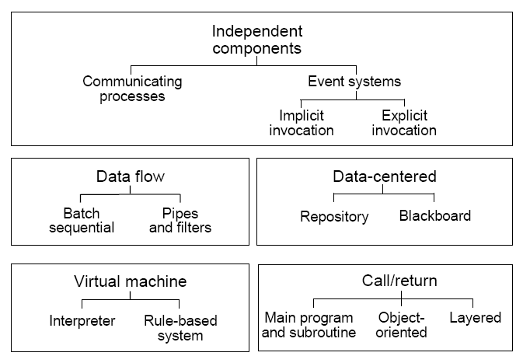
经典体系结构风格的分类
独立构件
事件系统
进程通信
隐式调用
显式调用
数据流
以数据为中心
批处理
仓库
黑板
管道-过滤器
调用-返回
虚拟机
解释器
分层
基于规则
的系统
主程序-子过程
OO

Slide 14
本课程所要学习的SA风格
<1> 调用/返回风格：主程序/子程序；面向对象；
<2> 数据流风格：批处理；管道/过滤器；过程控制；
<3> 独立构件风格：事件系统；
<4> 虚拟机风格：解释器；基于规则的系统；
<5> 调用/返回风格：层次结构；
<6> 层次结构风格的典型实例：C/S结构；B/S结构；
<7> 以数据为中心的风格：仓库；黑板；
<8> 新型体系结构风格：MVC；Cluster；SOA；Cloud。

Slide 15
纯粹的体系结构风格？
When we introduce a new style, we will typically first examine its “pure” form.
  pure architectural style are rarely found in practice
  纯粹的体系风格在实际中很难遇到
  systems in practice
    regularly deviate from the academic definitions of these systems.
    通常与学术定义相偏离
    typically feature many architectural styles simultaneously
    典型地，融合很多体系风格的特色
  as an architect you must understand the “pure” styles to understand the strength and weaknesses of the style as well as the consequences of deviating from the style
  作为一个架构师，你必须理解“纯”的风格。理解它的优点与缺陷，也要理解背离此种风格之后会带来什么结果

Slide 16
主要内容

Slide 17
3.2 主程序-子过程风格
Main program and subroutine

Slide 18
Evolution of Program Design
Examples
1950s-1960s
“simple” program models
COBOL, Algol, BASIC
1970s -1980s
Zenith of structured programming- especially Pascal.
Pascal, C, Fortran, Perl
First object-oriented languages (esp C++)
Ada, C++, JAVA, SmallTalk
1990’s-
traditional languages “converted” to OOP
Visual Basic, Delphi (Object Pascal), Perl 5, (e.g. BioPerl)

Slide 19
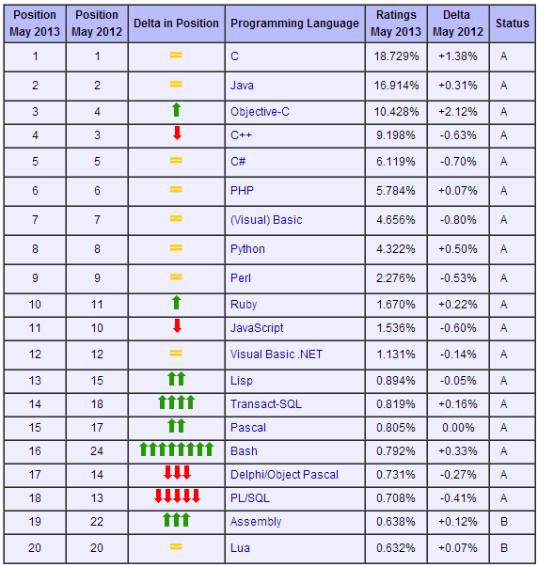
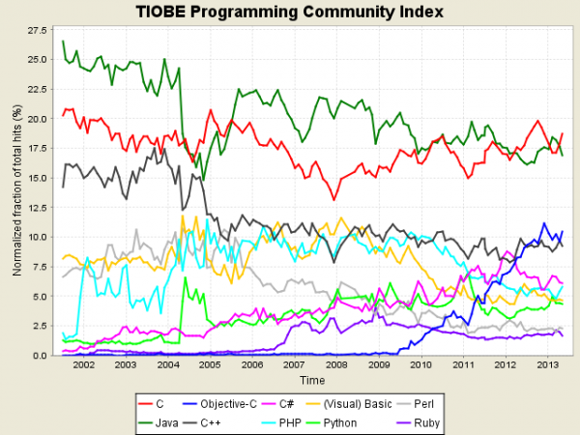

Slide 20
非结构化的程序(Unstructured programming)
All the program code written in a single continuous main program (所有的程序代码均包含在一个主程序文件中).
Disadvantages for large programs (缺陷):
  difficult to follow logic (逻辑不清)
  if something needs to be done more than once must be re-typed (无法复用)
  hard to incorporate other code (难以与其他代码合并)
  not easily modified (难于修改)
  difficult to test particular portions of the code (难以测试特定部分的代码)

Slide 21
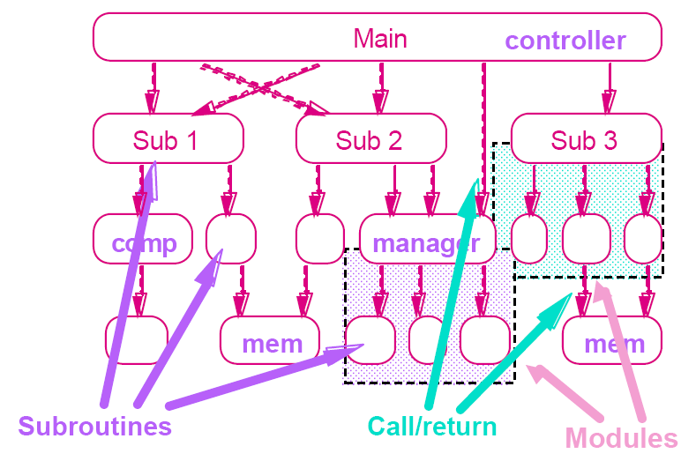
主程序-子过程风格(Main program and subroutine)

Slide 22
结构化程序：自上而下的设计(Top-down Design)
Problem
Task 1
Task 2
Task 3
high-level
subtasks
more primitive
subtasks
individual
statements

Slide 23
结构化程序：逐层分解 (Hierarchical decomposition)
The system is designed from a functional viewpoint, starting with a high-level view and progressively refining this into a more detailed design (从功能的观点设计系统)
This methodology is exemplified by Structured Design and step-wise refinement (结构化设计与逐步细化是这种风格的典型实例)
Hierarchical decomposition (逐层分解):
  Based on definition-use relationship (基于“定义—使用”关系)
  Uses procedure call as interaction mechanism (用过程调用作为交互机制)
  Correctness of a subroutine depend on the correctness of the subroutines it calls (主程序的正确性依赖于它所调用的子程序的正确性)

Slide 24
主程序-子过程风格的基本构成
Component (构件：主程序、子程序)
  Main program and subroutines, hierarchically decomposing a program
Connector(连接器：调用-返回机制)
  Call-return mechanism, each component get control and data from its parent and pass it to children.
Topology(拓扑结构：层次化结构)
  Hierarchical structure
本质：将大系统分解为若干模块(模块化)，主程序调用这些模块实现完整的系统功能。

Slide 25
过程(函数)调用机制?
硬件基础(寄存器、跳转指令、栈操作指令)
实现机制
  栈是一种先进后出的数据结构。即先进栈的数据后出，而后进栈的数据先出。
  函数调用实际上是进行程序的跳转，在转去执行函数之前，应把现场保护起来(栈、寄存器)，以备函数执行完毕还回到刚才跳转的地方，接着执行后继程序。

Slide 26
主程序-子过程风格的优点与缺点
Advantage:
  This has proved to be a highly successful design methodology. It has allowed the development of large programs (100,000 lines or more of source code). (已被证明是成功的设计方法，可以被用于较大程序)
Disadvantages:
  However, as program size increases beyond this point (100,000 lines), the approach performs poorly. (程序超过10万行，表现不好)
  We observe that code development becomes too slow and that it becomes increasingly difficult to test the software and guarantee its reliability. (程序太大，开发太慢，测试越来越困难)

Slide 27
SA案例分析
Key Word in Context (KWIC)

Slide 28
KWIC: Functional Requirements
in 1974, Parnas proposed the following problem,The KWIC(keyword-in-context) index system (KWIC索引系统)
  accepts an ordered set of lines (接受一些行)
  each line is an ordered set of words (每行有若干词)
  each word is an ordered set of characters (每个词由若干字符组成)
  any line may be “circularly shifted” by repeatedly removing the first word and appending it at the end of the line (每行都可以循环移位:重复地把第一个词删除，然后接到行末)
  The KWIC index system outputs a listing of all circular shifts of all lines in alphabetical order. (KWIC把所有行的各种移位情况按照字母表顺序输出)
参见 Mary Shaw, David Garlan. Software Architecture: Perspectives on an Emerging Discipline. The 3rd Chapter.
...成为软件体系结构研究的经典案例

Slide 29
A case for KWIC
A third way for styles to
third way for styles to A
way for styles to A third
for styles to A third way
styles to A third way for
to A third way for styles
be combined is to
combined is to be
is to be combined
to be combined is
elaborate one level of
one level of elaborate
level of elaborate one
of elaborate one level
A third way for styles to
be combined is to
combined is to be
elaborate one level of
for styles to A third way
is to be combined
level of elaborate one
of elaborate one level
one level of elaborate
styles to A third way for
third way for styles to A
to A third way for styles
to be combined is
way for styles to A third
A third way for styles to
be combined is to
elaborate one level of
Input
(输入)
Circular shifts
(循环移位)
Order & Output
(排序输出)

Slide 30
KWIC: Non-functional Requirements
Modifiability (可修改性)
  Change in Algorithm (算法的变化)
    batch vs. incremental
  Change in Data Representation (数据表示方式的变化)
    line storage, explicit vs. implicit shifts
  Enhancement to system function (系统功能的可扩展性)
    e.g., eliminate lines starting with trivial words
    e.g., input lines from a database or from UI
    e.g., delete, modify or add to lines from the original shifted lines
Performance (性能)
  Both space and time (时空复杂性)
Reusability (系统构件的可复用性)
  To what extent can the components serve as reusable entities.

Slide 31
KWIC Solution: Main Program/Subroutine with Shared Data
采用“主程序-子过程”风格、对系统进行功能分解，是最自然的想法，也是“面向过程的编程” 的主要思路。
  Decomposes the problem according to the four basic functions performed: input, shift, alphabetize, and output. (分为四个基本功能：输入、移位、排序、输出)
  These computational components are coordinated as subroutines by a main program that sequences through them in turn. (主程序按次序调用这四个模块)
  Data is communicated between the components through shared storage with an unconstrained read-write protocol. (通过共享的数据存储和无约束的读-写协议在模块之间进行数据交换)

Slide 32
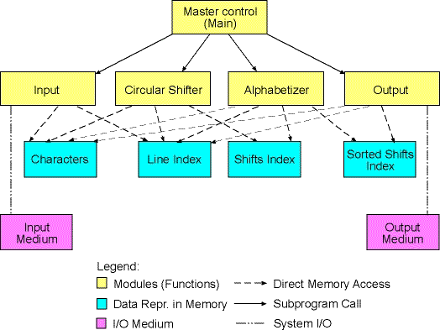
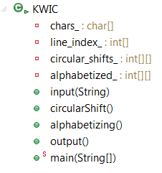
KWIC Solution: Main Program/Subroutine with Shared Data

Slide 33
KWIC: Data Representation
char[] chars_
  Characters from the input file are stored in a character array named chars_. Words are delimited by a single space character.
int[] line_index_
  An integer array, which keeps indices of characters from the character array. Each index kept in the line index array is the index of the first character of a particular line.
int[][] circular_shifts_
  Two dimensional array that stores the original line number and all of its circular shifts, stored as indexes of the original character array
int[][] alphabetized_
  Two dimensional array that stores alphabetized circular shifts

Slide 34
KWIC: Process
The input function is called to read and parse the lines from an input file and represents it by means of the character (chars_) and line index (line_index_) array. (首先调用input函数来读取和解析输入文件并将其写在chars_和line_index_数组中)
The main function calls the circularShift function, which produces circular shifts of each particular line and stores it in the circular shifts array (circular_shifts_). (然后调用circularShift函数，产生移位结果并写入circular_shifts_数组中)
The main function calls the alphabetize function, which sorts circular shifts alphabetically. The result is stored in the alphabetized array (alphabetized_). (然后调用alphabetize函数对其进行排序，结果写入alphabetized_数组中)
Finally, the main function calls the output function, which prints the sorted lines. (最后调用output函数，输出结果)

Slide 35
KWIC: Key Algorithm - input
The format of raw data is as follows.
  Lines are separated by the line separator character(s) (on Unix '\n', on Windows '\r\n'). Each line consists of a number of words. Words are delimited by any number and combination of the space chracter (' ') and the horizontal tabulation chracter ('\t').
The entered data is parsed in the following way.
  All line separators are removed from the data, all horizontal tabulation word delimiters are replaced by a single space character,
  and all multiple word delimiters are replaced by a single space character.
Then the parsed data is represented in core as two arrays.
  The first array is a char array (char[] chars_), which keeps all words seprated by a single space character. Since we removed line separators from the data the second integer array (int[] line_index_) keeps indexes of the chars_ array where lines start.

Slide 36
KWIC: Key Algorithm - circularShift
circularShift function processes the two arrays prepared by input function.
  It produces all circular shifts of all lines stored in core.
  A circular shift is a line where the first word is removed from the begin of a line and appended on the end of the line.
  To obtain all circular shifts of a line we repeat this process until we can't obtain any new lines.
We represent a circular shift of a line as a pair of indices.
  The first part of the pair is the index in the chars_ array, where the first word of the shifted line starts(在_array中的index).
  To be able to determine the boundaries of the original line, the second part of the pair keeps the index of the original line in the line index array(在_line_index中的index). Thus, all circular shifts are represented as an array of such pairs, i.e., as two dimensional integer array int[][] circular_shifts_.

Slide 37
KWIC Solution: Main Program/Subroutine with Shared Data
Advantages:
  Data can be represented efficiently, since computations can share the same storage. (模块之间的数据共享)
  Distinct computational aspects are isolated in different modules (不同的计算功能被隔离在不同的模块中)
Disadvantages:
  A change in data storage format will affect almost all of the modules. (对数据存储格式的变化将会影响几乎所有的模块)
  Changes in the overall processing algorithm and enhancements to system function are not easily accommodated. (对处理流程的改变与系统功能的增强也很难适应，依赖于控制模块内部的调用次序)
  This decomposition is not particularly supportive of reuse. (这种分解也难以支持有效的复用)

Slide 38
3.3 面向对象风格
OO systems

Slide 39
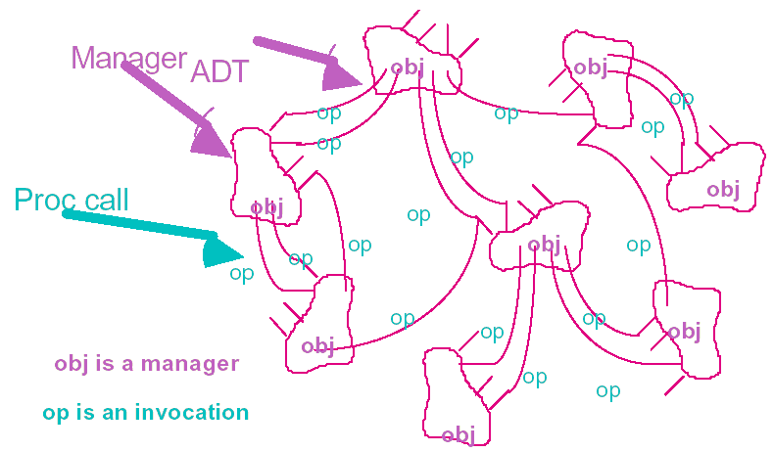
Object-Oriented Style
Object is also called abstract data type(ADT).
The system is viewed as a collection of objects rather than as functions with messages passed from object to object. (系统被看作对象的集合)
Each object has its own set of associated operations (每个对象都有一个它自己的功能集合。数据及作用在数据上的操作被封装成抽象数据类型——对象)

Slide 40
Main Program/Subroutine VS. OO
银行账户对象
存款
存
款
取
款
账户
余额
账户
余额
取款
利息结算
利息结算
外部消息
Information hidding (信息隐藏)
  encapsulation based on hiding of design “secrets” (内部的设计决策则被封装起来)

Slide 41
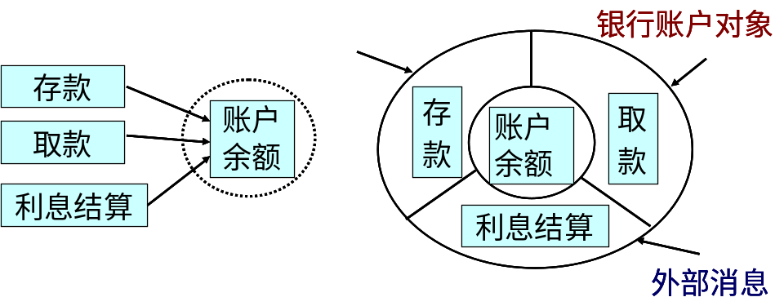
Core Characteristics of Object Architectures
encapsulation(封装)
  An object is responsible for preserving the integrity of its presentation(对象维护自身完整性,非常重要)
  And the presentation is hidden from other objects.(自身的表示对其他对象不可见,实现自身完整性重要前提)
Model the real world (模拟现实世界)
  Program with nouns not verbs (对名词而不是对动词编程)
  Entities defined by actions it suffers and requires (每个对象也定义了它所能执行的动作，以及可以作用在它上面的动作)

Slide 42
OO基本构成
Component: classes and objects (OO风格的构件是：类和对象)
Connectors: objects interact through function and procedure invocations. (连接件：对象之间通过功能与函数调用实现交互)

Slide 43
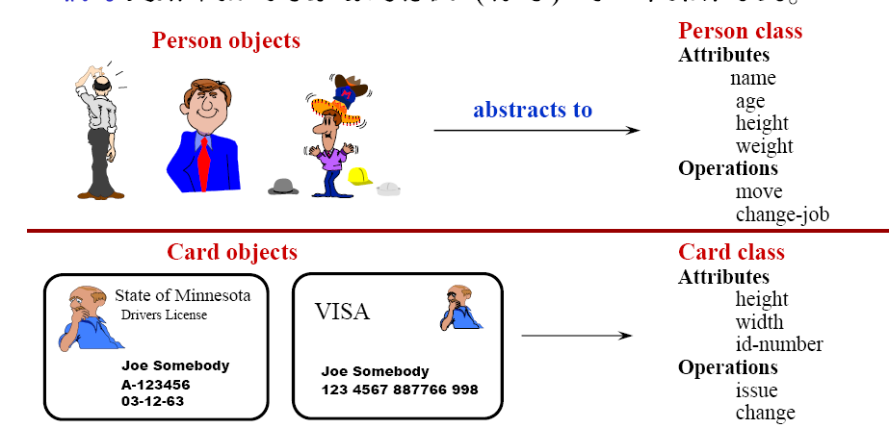
类的内部结构：属性和操作
属性(Attribute)：描述对象静态特性的数据项；
操作(Operation)：描述对象动态特性的一个动作；

Slide 44
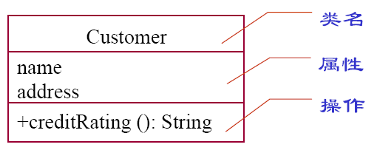
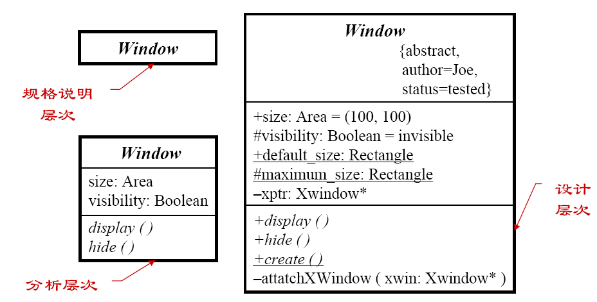
类的内部结构：属性和操作
类名
属性
操作
规格说明
层次
设计
层次
分析层次

Slide 45
Characteristics of OO
Interaction: Via procedure calls or similar protocol (交互：通过过程调用或类似的协议)
Encapsulation: Restrict access to certain information (封装：限制对某些信息的访问)
Polymorphism: Choose the method at run-time (多态：在运行时选择具体的操作)
Inheritance: Keep one definition of shared functionality (继承：对共享的功能保持唯一的接口)
Dynamic binding: Determine actual operation to call at runtime (动态绑定：运行时决定实际调用的操作)
Reuse and maintenance: Exploit capsulation and locality (复用和维护)

Slide 46
Advantages of OO
Reuse and maintenance: Exploit encapsulation and locality to increase productivity (复用和维护：利用封装和聚合提高生产力)
  It is possible to change the implementation without affecting its clients.
Real world mapping: For some systems, there may be an obvious mapping from real world entities to system objects (反映现实世界)
Easy decomposition of a system: the bundling of a set of accessing routines with the data they manipulate allows designers to decompose problems into collections of interacting agents. (容易分解一个系统)

Slide 47
Disadvantages of OO
Management of many objects: Need structure on large set of definitions (管理大量的对象：怎样确立大量对象的结构)
In order for one object to interact with another (via procedure call) it must know the identity of that object. (必须知道对象的身份)
  对比：在管道-过滤器系统中 (下一节介绍) ，一个过滤器无需知道其他过滤器的任何信息
Inheritance introduces complexity and this is undesirable, especially in critical systems (继承引起复杂度，关键系统中慎用)

Slide 48
Inheritance in C++ and Java
Father 1
Father 2
Only Father
Son
Son
In C++, one class can inherit from two classes
In Java, one class can only inherit from one class

Slide 49
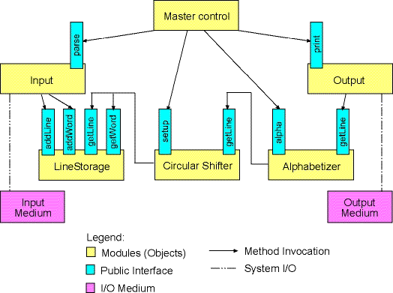
KWIC Solution: Abstract Data Types

Slide 50
KWIC Solution : Abstract Data Types
采用OO的思想，数据和作用在数据上的读写操作被封装为object，主程序调用这些object，形成控制流程；
  Data is no longer directly shared by the computational components. (数据不再被构件直接共享，而是被封装在了Object中)
  Each module provides an interface that permits other components to access data only by invoking procedures in that interface. (每个对象提供了一个接口，允许其他对象通过该接口调用对该对象内封装的数据的操作)

Slide 51
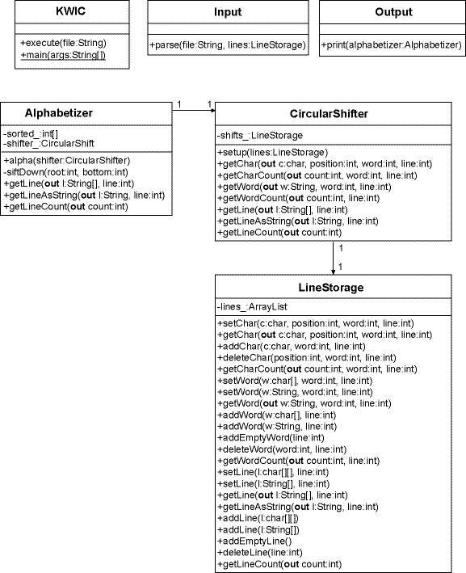
主控制程序
“输入”对象
“输出”对象
“排序”对象
“循环移位”对象
Class Diagram:
System Statics
“行数据存储”
对象

Slide 52
KWIC Solution : Abstract Data Types
Input object (负责从输入文件中读取数据并将其存储在LineStorage对象中)
LineStorage object (存储和处理字符、单词、行)
CircularShifter object (负责对LineStorage对象中存储的数据进行循环移位)
Alphabetizer object (负责对循环移位后得到的数据进行排序)
Output object (负责打印输出排序后的数据)
Master control object (主控制对象：负责控制其他各对象中方法的调用次序)

Slide 53
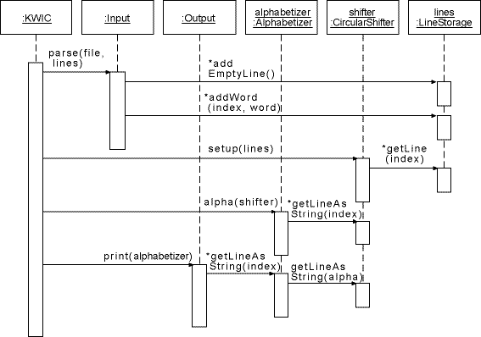
Sequence Diagram: System Dynamics
“循环
移位”
对象
“行数据
存储”
对象
主控制
程序
“输入”
对象
“输出”
对象
“排序”
对象

Slide 54
Class KWIC
//主对象KWIC构造五个对象实例
LineStorage lines = new LineStorage();
Input input = new Input();
CircularShifter shifter = new CircularShifter();
Alphabetizer alphabetizer = new Alphabetizer();
Output output = new Output();
//然后分别调用这五个对象实例的某些方法
input.parse(file, lines);
shifter.setup(lines);
alphabetizer.alpha(shifter);
output.print(alphabetizer);

Slide 55
KWIC Solution : Abstract Data Types
Advantages:
  Both algorithms and data representations can be changed in individual modules without affecting others. (某一构件的算法与数据结构的修改不会影响其他构件)
  Reuse is better supported than in the first solution because modules make fewer assumptions about the others with which they interact. (构件之间依赖性降低，提高了复用度)
Disadvantages:
  The solution is not particularly well-suited to enhancements. (不是特别适合功能的扩展)
  For adding new functions to the system, the implementor must either modify the existing modules or add new modules that lead to performance penalties. (为了增加新功能，要么修改已有的模块，要么就加入新的模块)

Slide 56
KWIC: Main Program/Subroutine VS. OO
从架构观点看，OO优于Main Program/Subroutine
  依赖减少
  易于理解
  易于维护
  易于复用

Slide 57
结束

